Slide 1
KNN - Algorithm

Slide 2

30 Days Python Master Class
Day1 : Python
Time: 6.00 PM IST
Free Registration

Slide 3
Python Master Class
Handbook

Slide 4
NANDHINI.S
Exp: 5 Yrs
Expert in
Python Developer on Machine Learning
Deep learning with computer vision
Matlab – Image Processing
Autonomous Car design using ROS with LIDAR
Language – Python , Java , HTML ,CSS.
Tools – ANACONDA NAVIGATOR, JUPYTER NOTEBOOK,
GOOGLE COLAB.
Graduation : BE – ECE | 2011

Slide 5
Pantech?
Educational Equipment Manufacturer
IoT, AI, Robotics,Autonomous Robot
Microprocessor/Microcontroller
DSP,VLSI, Embedded System
Power Electronics & Drives, Fuel Cell Trainer Kit
Renewable Energy Lab, Electric Vehicle Lab
Technical Training
DIY Project

Slide 6

What is Master Class ?
👍 This is the 30 Days Industrial Learning Activity.
👍 Its Online YouTube Live Class
👍 If you Invest 45 minutes daily, U will become Master in Data Science
👍 You will get FREE E-Certificate
Webinar Participation Certificate
“Learning is the beginning of wealth.
Searching & Learning is where the miracle process all begins.” …………….Jim Rohn

Slide 7
Our Vision
Help 10 Million Students to Learn the Technology in Easy Way

Slide 8

Associate Partner for this Master Class
https://apssdc.in/home/

Slide 9
What U will Learn from 30 Days Data Science & Analytics Master Class

Slide 10





Python Learning Plan
01
02
03
04
05
Library
Python
Analytics
Analytics
Industry Project
Introduction To Python and Python Data Structures
Pandas
Numpy
MatplotLib
Cborn, SKLearn Lib
Collab
Distribution
Visualization
Aggregation
Statistics
Distribution Function
Project Building

Slide 11
Day wise Learning Plan
Day -1 : Introduction to Python
Day -2: Python – Tools|Syntaxes & Data Structures
Day -3: Python – Dictionaries,Date and Time
Day -4: Python – MySql
Day -5: Pandas library – Introduction
Day -6: Pandas library – Data Structures
Day -7: Numpy library – Introduction
Day -8: Numpy library – Array Manipulations, Mathematical Functions
Day -9: Matplotlib , Histogram Using Matplotlib | I/O With Numpy
Day -10: Matplotlib Library - Introduction , Pyplot API | Types Of Plots
Day -11: Seaborn Library
Day -12: SKLearn Library
Day -13: Python – Date and Time , Data Wrangling.
Day -14: Python – Data Cleansing
Day -15: Python – Word Tokenization , Stemming and Lammetization.

Slide 12
Day wise Learning Plan
Day -16: Python – Data Visualization
Day -17: Python – Statistical Analysis
Day -18: Python – Types Of Distribution
Day -19: Python – Correlation ,Chi-Square Test , Linear Regression
Day -20: Keras library – Introduction.
Day -21: Stock Price Prediction With Machine Learning LSTM RNN
Day -22: People’s behaviour in chat message using NLP NLP
Day -23: Gaming In Python
Day -24: Chatbot creation in Python NLP
Day -25: Electricity Price Prediction Using ML Random Forest Regressor
Day -26: Diamond Price Prediction Using Python Linear Regression
Day -27: Book Recommendation System KNN
Day -28: Image Classification Using CNN CNN
Day -29: Titanic Survival Analysis Using ML Logistic Regression
Day -30: Blockchain in Python

Slide 13
List of Projects for Demo in YouTube Live
Stock Price Prediction With Machine Learning
People’s behaviour in chat message using NLP
Gaming In Python
Chatbot creation in Python
Electricity Price Prediction Using ML
Diamond Price Prediction Using Python
Book Recommendation System
Image Classification Using CNN
Titanic Survival Analysis Using ML
Blockchain in Python
All Projects in Jupyter Notebook

Slide 14
What you will get from this Free 30 Days Master Class?
You can attend YouTube Live Class
Free E-Certificate ( WEBINAR PARTICIPATION CERTIFICATE)

Slide 15
How to mark your Attendance in YouTube Live Class?
Ans : During the Live Class, organizer will post Google Form link in Live Chat. The Participants should submit the from on daily basis. Minimum 25 Days Attendance is Required to get Free Master Class Participation Certificate.
Note : The Link will be available during the Live. From the LIVE Class date, the live video will get removed from the YouTube in 3 days.

Slide 16
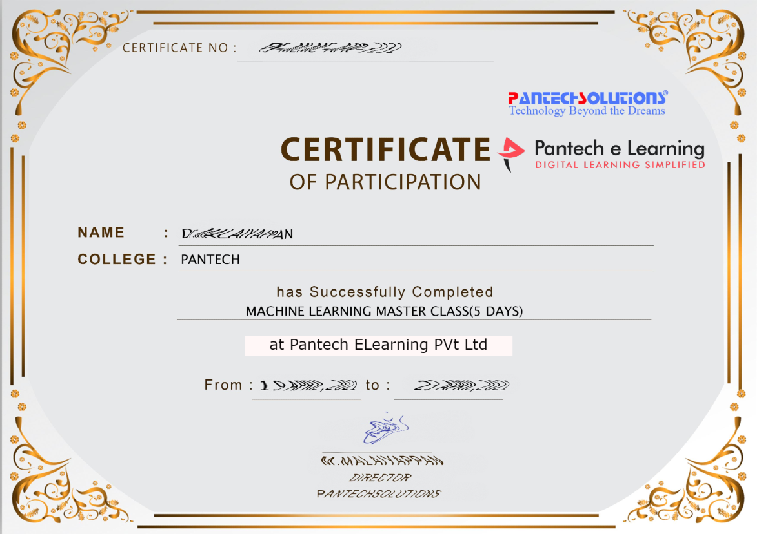

Sample Webinar Participation Certificate?

Slide 17
https://www.pantechelearning.com/data-science-master-class/
On Demand
You can get chance to apply 1 Month Internship on Data Science & Analytics Master Class

Slide 18
What is Internship????
Learn
Practice
Verify
Get Certified
Grow

Slide 19
Free Master Class DSA | 1 Month Internship on DSA
Master Class Participation Certificate | Internship Completion Certificate
Minimum 25 Class should attend YouTube Live | Recorded Class Link will be provided. – LMS Portal Access
YouTube Live Mandatory | Your Choice. You can attend Live or else You can watch Recorded Class in LMS Portal
All Projects Demo class in YouTube Live | Step by Step Video Explanation Content in LMS Portal
Access : 3 Days | VIP WhatsApp Group Support
 | You Can Download All PPTs
 | 4 Nos of Hackathon Class in Zoom Live. The Recording also will be provided
 | You Can Download All Project Files
 | Mentor will guide you to finish 10 Projects
 | Access : 60 Days

Slide 20
Pantech will make you to Create 10 Projects in Data Science & Analytics in 30 Days
Objective of this 30 Days Master Class

Slide 21
1 Month Internship in Data Science
INTERNSHIP E-Certificate(30Days Internship on Data Science Engineering)
Highly organized Video content
Download All Files
Download PPTs
Assignments
Flexible Time.
Access Period: 60Days from the date of payment

Slide 22
What You Will Get???
Complete Project Files
30 Days Learning Activity
Data Science Core Concepts
10 + Projects
Project PPT
Spatial Data Science For Covid-19 Disease Prediction
Parkinson’s Disease Prediction-XGBoost Classifier
House Price Prediction-Random Forest Regression
Customer Segmentation Using ML-K-Means Clustering
Home Loan Prediction-Decision Tree Classifier
Spam Classification-NLP
Hand Written Digit Recognition Using Python-CNN
Churn Prediction-Deep Learning
Crop Yield Prediction
Ground water level prediction
Video Class Access for 2 Months
Get chance to Enroll 1-Month Internship on demand

Slide 23

How to join in 1 month Internship
https://www.pantechelearning.com/pymc-internship/
Coupon Code: PYMC

Slide 24
Overview:
K Nearest Neighbor (KNN) is intuitive to understand and an easy to implement the algorithm. Beginners can master this algorithm even in the early phases of their Machine Learning studies.
This KNN article is to:
· Understand K Nearest Neighbor (KNN) algorithm representation and prediction.
· Understand how to choose K value and distance metric.
· Required data preparation methods and Pros and cons of the KNN algorithm.
· Pseudocode and Python implementation.

Slide 25
Introduction:
K Nearest Neighbor algorithm falls under the Supervised Learning category and is used for classification (most commonly) and regression. It is a versatile algorithm also used for imputing missing values and resampling datasets. As the name (K Nearest Neighbor) suggests it considers K Nearest Neighbors (Data points) to predict the class or continuous value for the new Datapoint.
The algorithm’s learning is:
1. Instance-based learning: Here we do not learn weights from training data to predict output (as in model-based algorithms) but use entire training instances to predict output for unseen data.
2. Lazy Learning: Model is not learned using training data prior and the learning process is postponed to a time when prediction is requested on the new instance.
3. Non -Parametric: In KNN, there is no predefined form of the mapping function.

Slide 26
How does KNN Work?
Principle:
Consider the following figure. Let us say we have plotted data points from our training set on a two-dimensional feature space. As shown, we have a total of 6 data points (3 red and 3 blue). Red data points belong to ‘class1’ and blue data points belong to ‘class2’. And yellow data point in a feature space represents the new point for which a class is to be predicted. Obviously, we say it belongs to ‘class1’ (red points)
Why?
Because its nearest neighbors belong to that class!

Slide 27
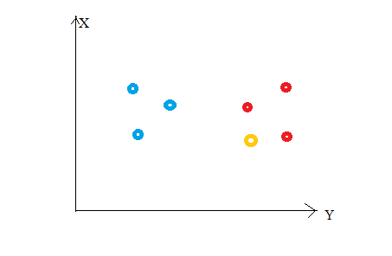
How does KNN Work?

Slide 28
How does KNN Work?
Yes, this is the principle behind K Nearest Neighbors. Here, nearest neighbors are those data points that have minimum distance in feature space from our new data point. And K is the number of such data points we consider in our implementation of the algorithm. Therefore, distance metric and K value are two important considerations while using the KNN algorithm. Euclidean distance is the most popular distance metric. You can also use Hamming distance, Manhattan distance, Minkowski distance as per your need. For predicting class/ continuous value for a new data point, it considers all the data points in the training dataset. Finds new data point’s ‘K’ Nearest Neighbors (Data points) from feature space and their class labels or continuous values.

Slide 29
How does KNN Work?
Then:
For classification: A class label assigned to the majority of K Nearest Neighbors from the training dataset is considered as a predicted class for the new data point.
For regression: Mean or median of continuous values assigned to K Nearest Neighbors from training dataset is a predicted continuous value for our new data point

Slide 30
Model Representation
Here, we do not learn weights and store them, instead, the entire training dataset is stored in the memory. Therefore, model representation for KNN is the entire training dataset.

Slide 31
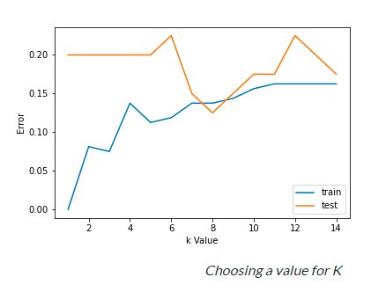
How to choose the value for K?
K is a crucial parameter in the KNN algorithm. Some suggestions for choosing K Value are:
1. Using error curves: The figure below shows error curves for different values of K for training and test data.

Slide 32
How to choose the value for K?
At low K values, there is overfitting of data/high variance.
Therefore test error is high and train error is low. At K=1 in train data, the error is always zero, because the nearest neighbor to that point is that point itself.
Therefore though training error is low test error is high at lower K values. This is called overfitting.
As we increase the value for K, the test error is reduced.

Slide 33
How to choose the value for K?
But after a certain K value, bias/ underfitting is introduced and test error goes high. So we can say initially test data error is high(due to variance) then it goes low and stabilizes and with further increase in K value, it again increases(due to bias). The K value when test error stabilizes and is low is considered as optimal value for K. From the above error curve we can choose K=8 for our KNN algorithm implementation.
2. Also, domain knowledge is very useful in choosing the K value.
3. K value should be odd while considering binary(two-class) classification

Slide 34
Required Data Preparation:
1.Data Scaling: To locate the data point in multidimensional feature space, it would be helpful if all features are on the same scale. Hence normalization or standardization of data will help.
2. Dimensionality Reduction: KNN may not work well if there are too many features. Hence dimensionality reduction techniques like feature selection, principal component analysis can be implemented.
3. Missing value treatment: If out of M features one feature data is missing for a particular example in the training set then we cannot locate or calculate distance from that point. Therefore deleting that row or imputation is required.

Slide 35
Python implementation:
Implementation of the K Nearest Neighbor algorithm using Python’s scikit-learn library:
Step 1: Get and prepare data
import pandas as pd
import numpy as np
import matplotlib.pyplot as plt
from sklearn.datasets import make_classification
from sklearn.model_selection import train_test_split
from sklearn.preprocessing import StandardScaler
from sklearn.neighbors import KNeighborsClassifier
from sklearn import metrics

Slide 36
Python implementation:
After loading important libraries, we create our data using sklearn.datasets with 200 samples, 8 features, and 2 classes.
Then data is split into the train(80%) and test(20%) data and scaled using StandardScaler.
X,Y=make_classification(n_samples= 200,n_features=8,n_informative=8,n_redundant=0,n_repeated=0,n_classes=2,random_state=14)
X_train, X_test, y_train, y_test= train_test_split(X, Y, test_size= 0.2,random_state=32)
sc= StandardScaler()
sc.fit(X_train)
X_train= sc.transform(X_train)
sc.fit(X_test)
X_test= sc.transform(X_test)
X.shape

Slide 37
Python implementation:
Step 2: Find the value of K
For choosing the K value, we use error curves and K value with optimal variance, and bias error is chosen as K value for prediction purposes.
With the error curve plotted below, we choose K=7 for the prediction.
error1= []
error2= []
for k in range(1,15):
knn= KNeighborsClassifier(n_neighbors=k)
knn.fit(X_train,y_train)
y_pred1= knn.predict(X_train)
error1.append(np.mean(y_train!= y_pred1))
y_pred2= knn.predict(X_test)
error2.append(np.mean(y_test!= y_pred2))

Slide 38
Python implementation:
# plt.figure(figsize(10,5))
plt.plot(range(1,15),error1,label="train")
plt.plot(range(1,15),error2,label="test")
plt.xlabel('k Value')
plt.ylabel('Error')
plt.legend()

Slide 39
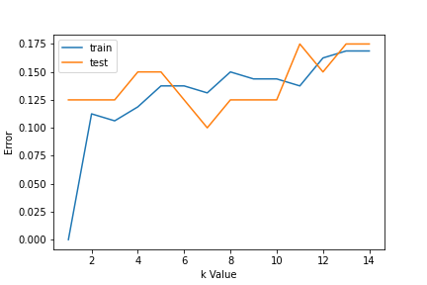
Python implementation:

Slide 40
Python implementation:
Step 3: In step 2, we have chosen the K value to be 7. Now we substitute that value and get the accuracy score = 0.9 for the test data.
knn= KNeighborsClassifier(n_neighbors=7)
knn.fit(X_train,y_train)
y_pred= knn.predict(X_test)
metrics.accuracy_score(y_test,y_pred)

Slide 41
Pseudocode for K Nearest Neighbor (classification):
This is pseudocode for implementing the KNN algorithm from scratch:
Load the training data.
Prepare data by scaling, missing value treatment, and dimensionality reduction as required.
Find the optimal value for K:
Predict a class value for new data:
Calculate distance(X, Xi) from i=1,2,3,….,n. where X= new data point, Xi= training data, distance as per your chosen distance metric.
Sort these distances in increasing order with corresponding train data.
From this sorted list, select the top ‘K’ rows.
Find the most frequent class from these chosen ‘K’ rows. This will be your predicted class.

Slide 42
Advantages and Disadvantages:
1. No Training Period: KNN is called Lazy Learner (Instance based learning). It does not learn anything in the training period. It does not derive any discriminative function from the training data. In other words, there is no training period for it. It stores the training dataset and learns from it only at the time of making real time predictions. This makes the KNN algorithm much faster than other algorithms that require training e.g. SVM, Linear Regression etc.

Slide 43
Advantages
2.Since the KNN algorithm requires no training before making predictions, new data can be added seamlessly which will not impact the accuracy of the algorithm. 3. KNN is very easy to implement. There are only two parameters required to implement KNN i.e. the value of K and the distance function (e.g. Euclidean or Manhattan etc.)

Slide 44
Disadvantages:
Does not work well with large dataset: In large datasets, the cost of calculating the distance between the new point and each existing points is huge which degrades the performance of the algorithm. 2. Does not work well with high dimensions: The KNN algorithm doesn't work well with high dimensional data because with large number of dimensions, it becomes difficult for the algorithm to calculate the distance in each dimension. 3.

Slide 45
Disadvantages:
3.Need feature scaling: We need to do feature scaling (standardization and normalization) before applying KNN algorithm to any dataset. If we don't do so, KNN may generate wrong predictions. 4. Sensitive to noisy data, missing values and outliers: KNN is sensitive to noise in the dataset. We need to manually impute missing values and remove outliers.

